Slide 1



HEARTS AND MINDS · A PATIENT'S STORY THROUGH THE OPERATING MODEL, GP-INITIATED, TOLD AS AN ILLUSTRATION
Layla.
Three years on the tablets. The trend is the treatment.
Layla is 42, a single parent with two school-age kids and two part-time jobs, one of them on shifts. Her iron deficiency anaemia was diagnosed three years ago; she has been on ferrous sulphate since, and her GP, Hannah, needs a full blood count and ferritin every six months to know whether it is still working. Nobody doubts Layla will take the tablets. The question is whether anyone will see the trend. This is the story of a monitoring cycle that holds because it stopped asking for her working hours. It is told as an illustration: the anaemia configuration is held under the Prioritisation Framework, not in build.
Layla
GP-initiated patient · Iron deficiency anaemia · held configuration
Hearts and Minds · Layla's journey · HomeTest operating model · September 2026
Commercial positions are agreed in principle and remain subject to the live procurement.
Notes:
Layla's story, told through the operating model. Open on the person, not the pathway.

Slide 2
LAYLA'S JOURNEY AT A GLANCE
Known, treated, and never quietly lost.
1
→
2
→
3
→
4
→
5
Stratification
Identification
Diagnosis
Treatment
Long-term optimisation
a treated condition and a cycle nobody can see slipping
the practice system orders and nobody has to ask
a sample between shifts
the dose follows the ferritin
silence as the good result
THE PATIENT NORTH STAR
WHY THIS WORKS FOR HER
Known, treated, and never quietly lost.
Her hours change every week. The kit does not care.
Layla is not a diagnosis waiting to happen. She is a patient the system already knows and already treats. The failure mode for someone like her is not a missed screen but a missed check: a six-month cycle that slips to nine, then twelve, while the iron dose that was right three years ago quietly stops being right. Hold the cycle and you hold the treatment.
Two part-time jobs, one on a rota that moves, mean a fixed clinic slot is a bet against her own timetable, and an hour in a waiting room is an hour she is not paid for. A kit that arrives when the cycle is due and gets taken between shifts costs her nothing she cannot spare. The result goes to Hannah. Layla hears from the practice only if the dose needs to change.
Layla
GP-initiated patient · Iron deficiency anaemia · held configuration
Hearts and Minds · Layla's journey · HomeTest operating model · September 2026
Commercial positions are agreed in principle and remain subject to the live procurement.
2

Slide 3

LAYLA'S JOURNEY · STAGE 1 OF 5
01
Stratification
a treated condition and a cycle nobody can see slipping
Around 8% of adult women in the UK live with iron deficiency anaemia. For most, treatment is a tablet and a blood test every six months. The test is the only way anyone knows whether the tablet is working, and it is the part that falls away when a life runs on shifts.
“I take the tablets every day. It is the blood test I keep missing, and that is the bit that tells them whether the tablets are doing anything.” Layla
WHAT THE MODEL IS DOING UNDERNEATH
THE OLD WAY
NICE clinical knowledge summaries place IDA prevalence at around 8% in adult UK women. Treatment response is monitored by full blood count and ferritin, typically at six-monthly intervals for a patient on long-term iron. The cohort is already known to primary care; the risk is the interval quietly stretching, not the diagnosis being missed.
Treat a treated cohort as if attendance were the patient's job. When the six-month check slips, send a letter. When the letter fails, close the recall and wait for her to come back symptomatic.
WHO LAYLA'S CARE TEAM SEES Hannah, GP. Practice nurse. Anita on the ICB / GP commissioner side, watching a monitoring cycle nobody can measure.
Hearts and Minds · Layla's journey · HomeTest operating model · September 2026
Commercial positions are agreed in principle and remain subject to the live procurement.
3
Notes:
Stage 1: Stratification. NICE clinical knowledge summaries place IDA prevalence at around 8% in adult UK women. Treatment response is monitored by full blood count and ferritin, typically at six-monthly intervals for a patient on long-term iron. The cohort is already known to primary care; the risk is the interval quietly stretching, not the diagnosis being missed.

Slide 4

LAYLA'S JOURNEY · STAGE 2 OF 5
02
Identification
the practice system orders and nobody has to ask
Hannah's recall search flags Layla as due. In the GP-initiated pattern the practice system raises the order for the FBC and ferritin, the platform ships the kit, and the appointment Layla could never keep is never booked. There is no conversation to have, because there is nothing for Layla to agree to yet.
“Nobody rang me. A text said a kit was coming for my six-month bloods, and it came. That was the whole appointment.” Layla
WHAT THE MODEL IS DOING UNDERNEATH
THE OLD WAY
Around 15 million general-practice appointments are missed each year, costing the NHS £216 million. The GP-initiated pattern removes the appointment rather than chasing it: the order originates in the practice system as part of the review cycle, the kit is dispatched against it, and the result is written back to the GP record. Layla is the sample provider, not the orderer or the recipient.
Book, miss, re-book, miss, then a DNA code on the record that follows her into every future conversation about engagement.
WHO LAYLA'S CARE TEAM SEES Hannah. The practice recall administrator. The supplier dispatching against the practice order. Anita, whose access figures stop counting Layla as a failure.
Hearts and Minds · Layla's journey · HomeTest operating model · September 2026
Commercial positions are agreed in principle and remain subject to the live procurement.
4
Notes:
Stage 2: Identification. Around 15 million general-practice appointments are missed each year, costing the NHS £216 million. The GP-initiated pattern removes the appointment rather than chasing it: the order originates in the practice system as part of the review cycle, the kit is dispatched against it, and the result is written back to the GP record. Layla is the sample provider, not the orderer or the recipient.

Slide 5

LAYLA'S JOURNEY · STAGE 3 OF 5
03
Diagnosis
a sample between shifts
The kit arrives on a Wednesday. Layla takes the capillary sample at the kitchen table while the kids finish their homework, before her evening shift, posts it on the way in and does not think about it again. The lab processes it on the same platform as any clinic sample and the result lands in Hannah's record on time.
“Twenty minutes between the kids' homework and the start of my shift. I would not have got to the surgery and back in that gap, let alone waited.” Layla
WHAT THE MODEL IS DOING UNDERNEATH
THE OLD WAY
The home capillary FBC and ferritin are a recognised route for routine monitoring. The sample is processed at a UKAS-accredited lab on the same assay platform that processes in-clinic samples, and the result writes back to the practice EPR through the framework integration. Nothing about the clinical standard changes; only the venue and the timing do.
An appointment at the surgery in working hours, which for Layla means an hour of unpaid time and a manager she has to ask twice a year, or a check that does not happen.
WHO LAYLA'S CARE TEAM SEES The supplier shipping the kit. The lab. The platform writing the result back. Layla, on her own timetable.
Hearts and Minds · Layla's journey · HomeTest operating model · September 2026
Commercial positions are agreed in principle and remain subject to the live procurement.
5
Notes:
Stage 3: Diagnosis. The home capillary FBC and ferritin are a recognised route for routine monitoring. The sample is processed at a UKAS-accredited lab on the same assay platform that processes in-clinic samples, and the result writes back to the practice EPR through the framework integration. Nothing about the clinical standard changes; only the venue and the timing do.

Slide 6

LAYLA'S JOURNEY · STAGE 4 OF 5
04
Treatment
the dose follows the ferritin
Hannah reviews the haemoglobin and ferritin against the previous cycles. This time the ferritin has plateaued below target, so the dose is adjusted and a note goes to Layla. Same clinical decision as an in-clinic sample would have prompted, with one difference: it happened on time, so the trend was still readable.
“A message from the practice: we are changing your dose, here is why, the new prescription is at the pharmacy. I read it on my break.” Layla
WHAT THE MODEL IS DOING UNDERNEATH
THE OLD WAY
The treatment pathway is NICE-guideline-aligned and unchanged by the home venue: iron supplementation is titrated to the FBC and ferritin response, and the GP holds prescribing accountability. What the home cycle adds is timeliness. A dose that needs changing gets changed at six months, not at fourteen.
A result reviewed months late, if at all, and a dose change made on a trend with a hole in it.
WHO LAYLA'S CARE TEAM SEES Hannah. Practice pharmacist for the dose change. The community pharmacy that already has her prescription.
Hearts and Minds · Layla's journey · HomeTest operating model · September 2026
Commercial positions are agreed in principle and remain subject to the live procurement.
6
Notes:
Stage 4: Treatment. The treatment pathway is NICE-guideline-aligned and unchanged by the home venue: iron supplementation is titrated to the FBC and ferritin response, and the GP holds prescribing accountability. What the home cycle adds is timeliness. A dose that needs changing gets changed at six months, not at fourteen.

Slide 7
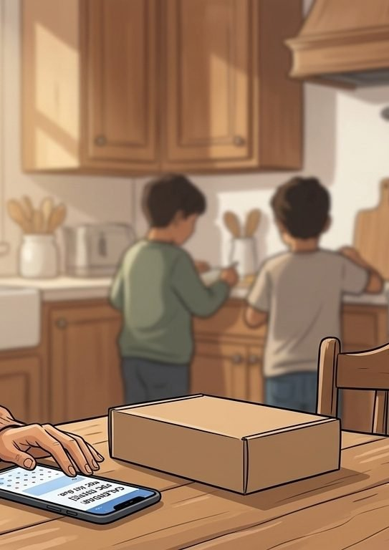
LAYLA'S JOURNEY · STAGE 5 OF 5
05
Long-term optimisation
silence as the good result
The cycle holds. The next kit is dated for six months, tied to the practice recall rather than to Layla's memory or her rota. If the trend is steady she hears nothing, and nothing is the right answer. If it moves, she hears from Hannah. Either way the practice knows, which is the whole point.
“I used to feel like I was always about to be in trouble with the surgery. Now the only time I hear from them is when there is actually something to say.” Layla
WHAT THE MODEL IS DOING UNDERNEATH
THE OLD WAY
Sustained monitoring is the clinical outcome for a treated long-term condition. The home cycle keeps the interval honest, surfaces a falling ferritin at the point it can be corrected cheaply, and frees the practice nurse slot for patients who clinically need the room. The illustration ends where the configuration stands: held, low priority under the framework, and able to run on the same rails as every other primary-care cycle if the gate opens.
Drift out of the cycle for a year or two and re-present with a haemoglobin far lower than it needed to be. The risk was always in the interval, not in the patient.
WHO LAYLA'S CARE TEAM SEES Layla. Hannah. The practice nurse. The platform holding the recall date.
Hearts and Minds · Layla's journey · HomeTest operating model · September 2026
Commercial positions are agreed in principle and remain subject to the live procurement.
7
Notes:
Stage 5: Long-term optimisation. Sustained monitoring is the clinical outcome for a treated long-term condition. The home cycle keeps the interval honest, surfaces a falling ferritin at the point it can be corrected cheaply, and frees the practice nurse slot for patients who clinically need the room. The illustration ends where the configuration stands: held, low priority under the framework, and able to run on the same rails as every other primary-care cycle if the gate opens.

Slide 8

LAYLA'S WIN
Monitored on time. Paid for every shift. Known to the practice as a patient, not as a DNA code.
THE MONEY IN THIS STORY
If the iron deficiency configuration opens under a roadmap gate, the money would work the way every other primary-care cycle does: a cost per activity for each completed test, paid by the commissioner direct to the supplier, against a national ceiling. Nothing about Layla's economics is exotic. The saving is the string of missed and re-booked appointments the practice stops paying for in slots, letters and chased bookings, and the dose change that stops being fourteen months late.
Layla does not see the framework or the platform. She sees a text, a kit, twenty minutes between homework and a shift, and a message from Hannah only when something needs to change. The trend that tells the practice whether three years of tablets are still working stays readable, because the cycle stopped asking for the one thing she cannot give it: a fixed hour in a working week. The configuration is held, so this is an illustration of the GP-initiated pattern, not a live pathway. The point stands: hold the cycle and you hold the treatment.
Known, treated, and never quietly lost.
Layla
GP-initiated patient · Iron deficiency anaemia · held configuration
Hearts and Minds · Layla's journey · HomeTest operating model · September 2026
Commercial positions are agreed in principle and remain subject to the live procurement.
8

Slide 9
Layla
GP-initiated patient · Iron deficiency anaemia · held configuration
Known, treated, and never quietly lost.
Hearts and Minds · Layla's journey · HomeTest operating model · September 2026
Commercial positions are agreed in principle and remain subject to the live procurement.
9

